Slide 1
Lecture #10
SOFT COMPUTING
INT508

Slide 2
Adaptive Resonance Theory (ART)
ART stands for "Adaptive Resonance Theory", invented by Stephen Grossberg in 1976. ART represents a family of neural networks.
ART encompasses a wide variety of neural networks.
The basic ART System is an unsupervised learning model.
The term "resonance" refers to resonant state of a neural network in which a category prototype vector matches close enough to the current input vector.
ART matching leads to this resonant state, which permits
learning. The network learns only in its resonant state.

Slide 3
Adaptive Resonance Theory (ART)
ART neural networks are capable of developing stable clusters of arbitrary sequences of input patterns by self-organizing.
ART-1 can cluster binary input vectors.
ART-2 can cluster real-valued input vectors.
ART systems are well suited to problems that require online learning of large and evolving databases.

Slide 4
Adaptive Resonance Theory (ART)
"A system that must be able to learn to adapt to a changing environment (ie it must be plastic) but the constant change can make the system unstable, because the system may learn new information only by forgetting every thing it has so far learned.“
This phenomenon, a contradiction between plasticity and stability, is called plasticity - stability dilemma..

Slide 5
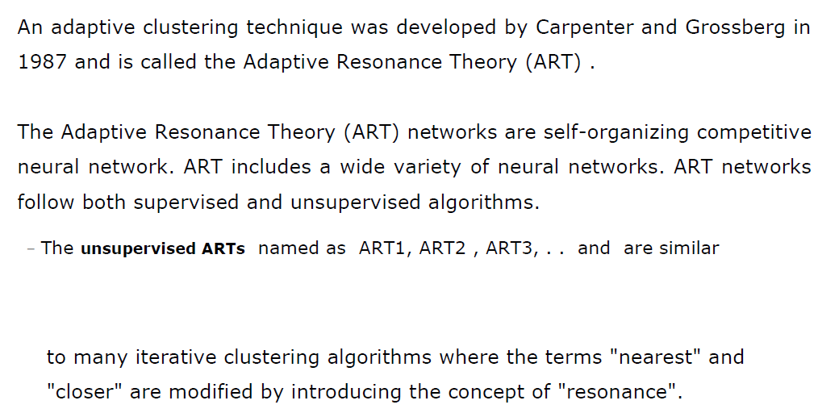
Adaptive Resonance Theory NN

Slide 6
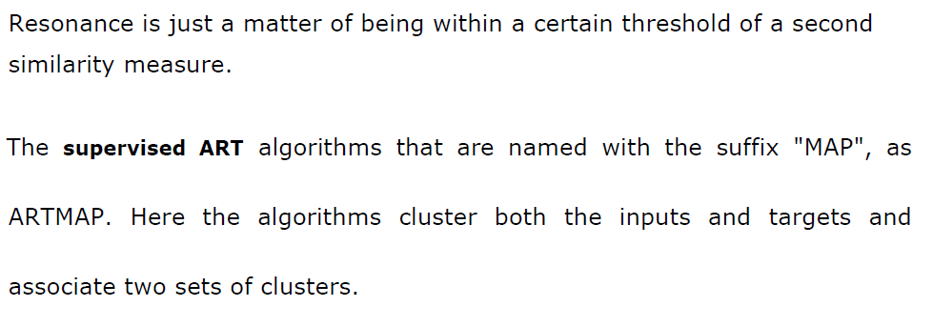
Adaptive Resonance Theory NN

Slide 7
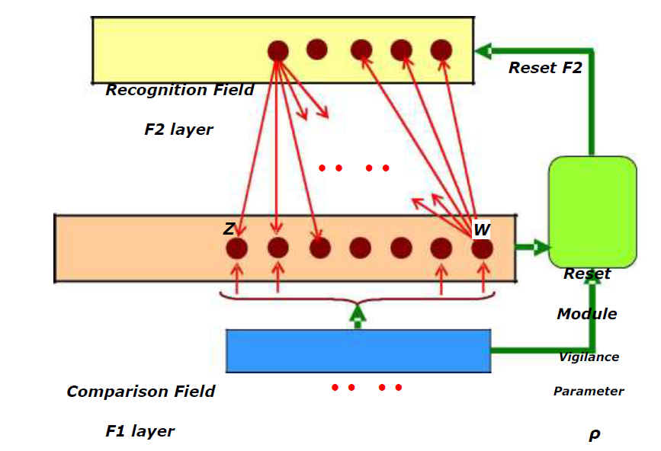
Adaptive Resonance Theory NN

Slide 8
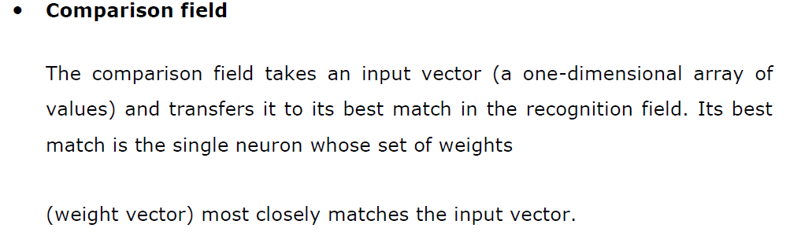
Adaptive Resonance Theory NN

Slide 9
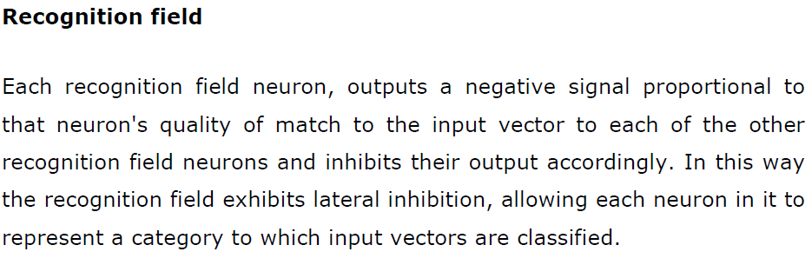
Adaptive Resonance Theory NN

Slide 10
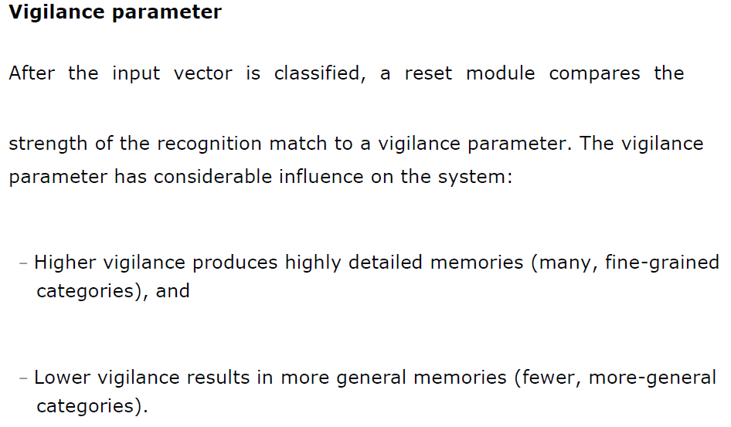
Adaptive Resonance Theory NN

Slide 11
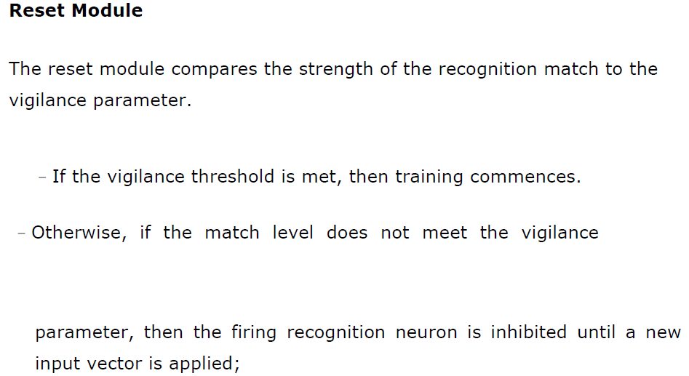
Adaptive Resonance Theory NN

Slide 12
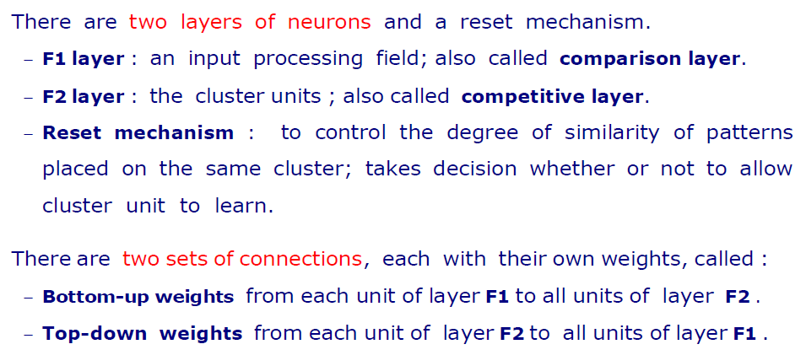
Adaptive Resonance Theory NN

Slide 13
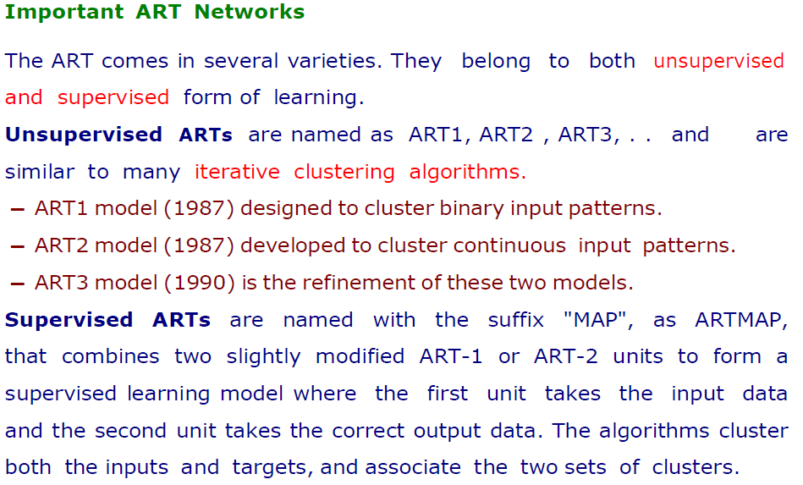
Adaptive Resonance Theory NN

Slide 14
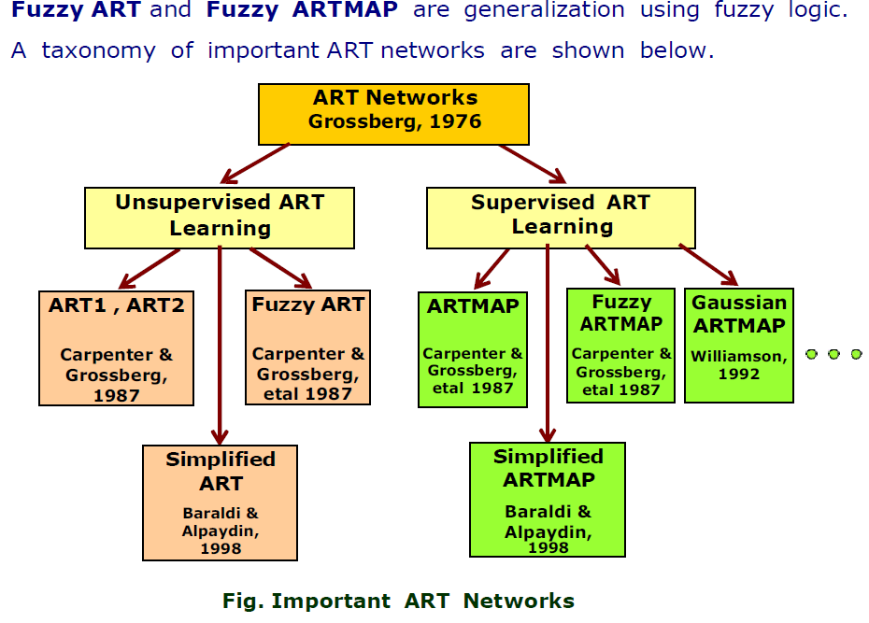
Adaptive Resonance Theory NN

Slide 15
Adaptive Resonance Theory NN
ART1 – It is the simplest and the basic ART architecture. It is capable of clustering binary input values.
ART2 – It is extension of ART1 that is capable of clustering continuous-valued input data.
Fuzzy ART – It is the augmentation of fuzzy logic and ART.
ARTMAP – It is a supervised form of ART learning where one ART learns based on the previous ART module. It is also known as predictive ART.
FARTMAP – This is a supervised ART architecture with Fuzzy logic included.

Slide 16
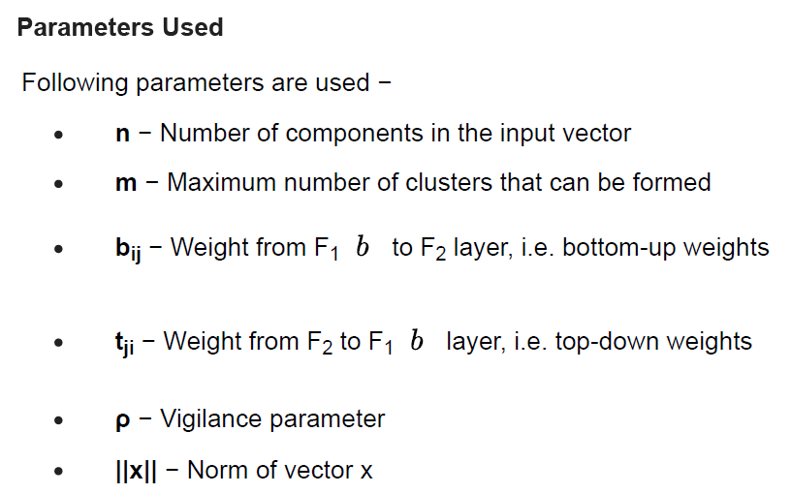
Adaptive Resonance Theory NN

Slide 17
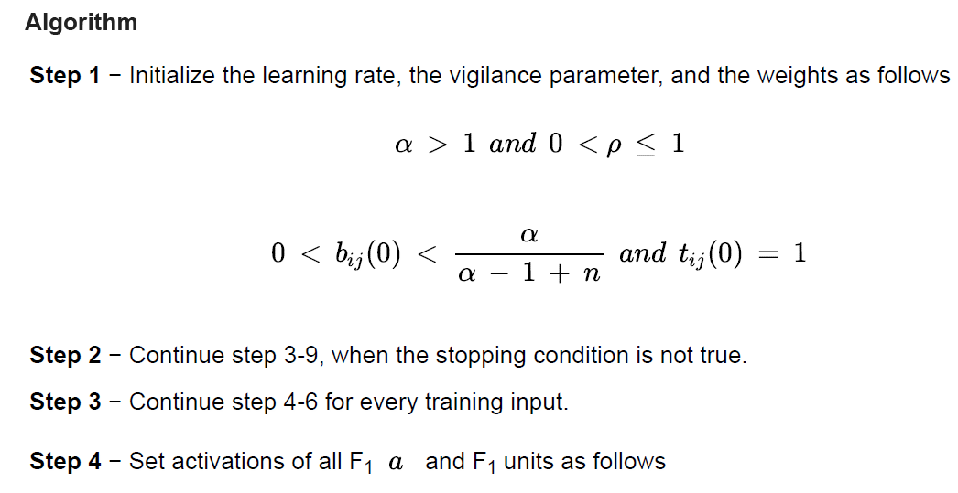
Adaptive Resonance Theory NN

Slide 18
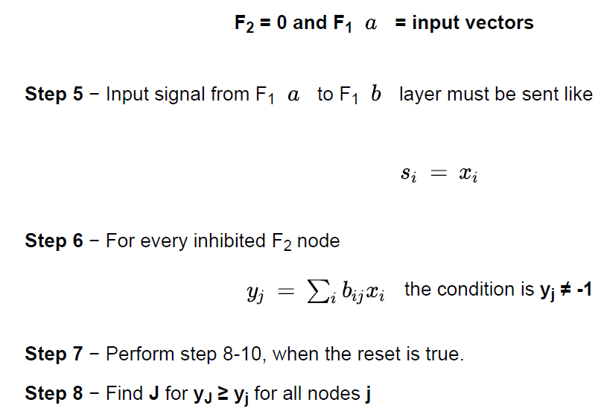
Adaptive Resonance Theory NN

Slide 19
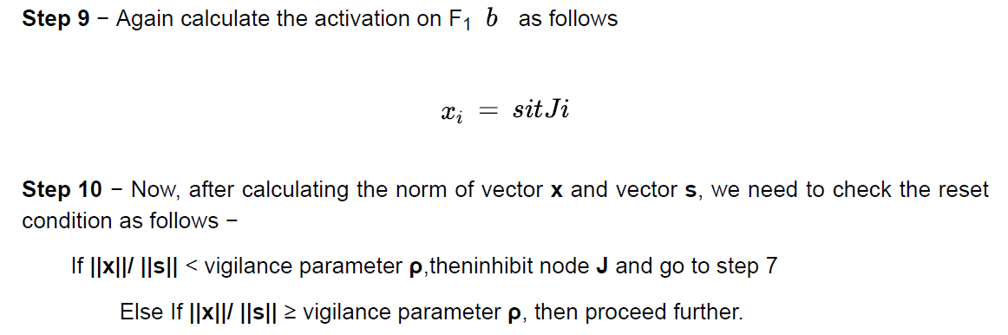
Adaptive Resonance Theory NN

Slide 20
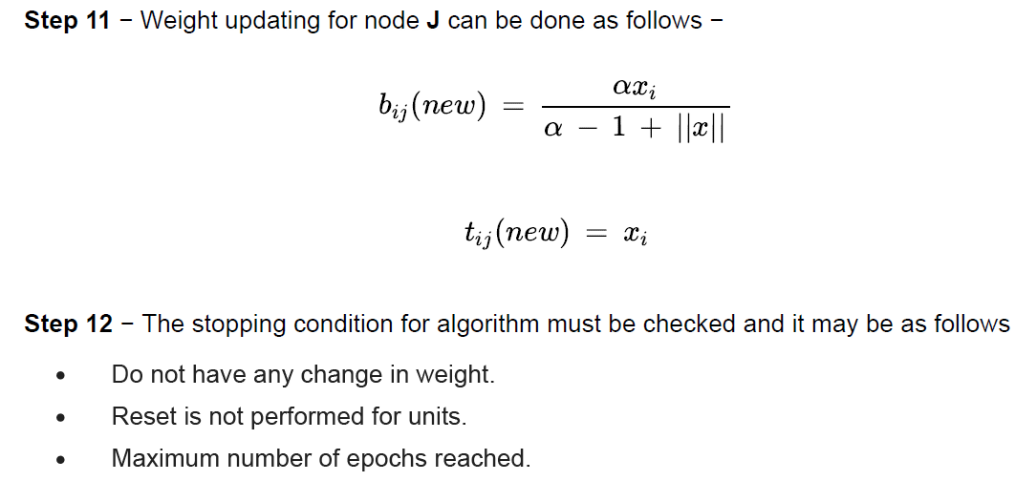
Adaptive Resonance Theory NN

Slide 21
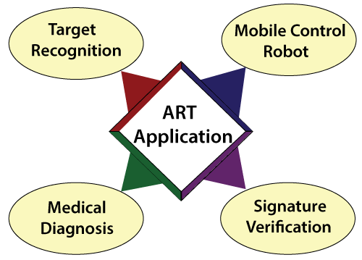
Adaptive Resonance Theory NN

Slide 22

12/12/14
CSE510, Lovely Professional University, Phagwara

